Slide 1


CITS1003 Introduction to Cybersecurity [1] Unit overview
Dr David Glance

Slide 2
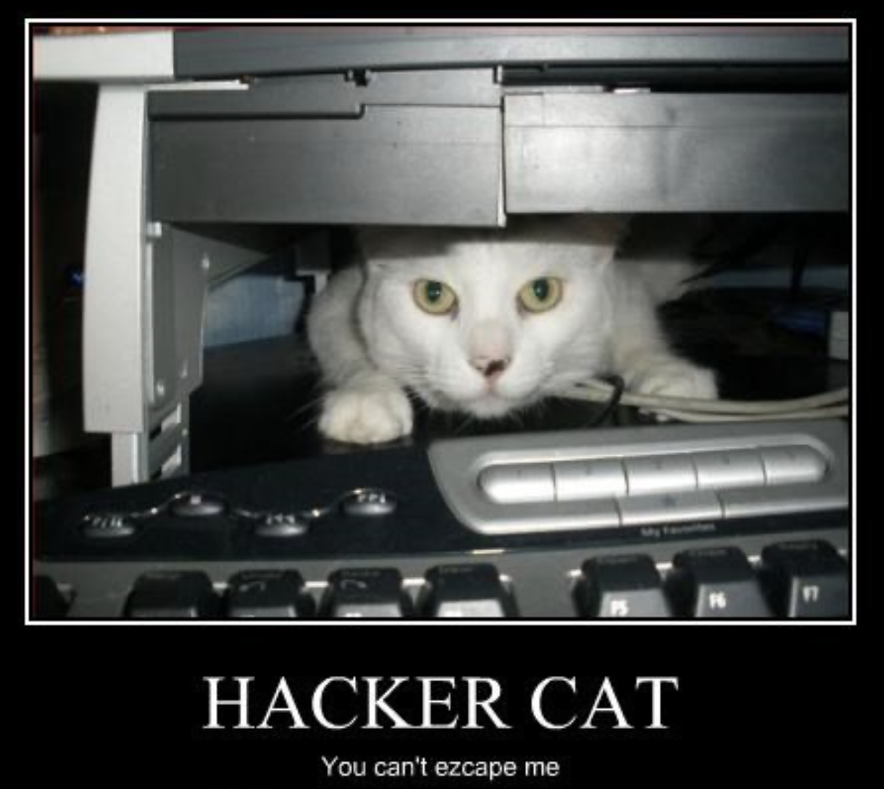
A unit about cats cybersecurity

Slide 3
Pre-Requisites and Target Audience
There will be no coding in this unit and no assumption of prior knowledge in computer science or mathematics
This is an introductory course and so suitable for anyone wishing to familiarise themselves with the terms and concepts of Cybersecurity
The course is based on CyBOK - the Cybersecurity Book of Knowledge project (https://www.cybok.org/)

Slide 4
Information Security
All human endeavour relies on information
Business, Government, Education, Research, Personal life
Information security is about protecting this information from “unauthorised access, harm or misuse”¹
This is done by preserving Confidentiality, Integrity and Availability of information

Slide 5
Cybersecurity
Cybersecurity is a subset of Information Security that concerns the digital realm – so:
Cyber security refers to the protection of information systems (hardware, software and associated infrastructure), the data on them, and the services they provide, from unauthorised access, harm or misuse. This includes harm caused intentionally by the operator of the system, or accidentally, as a result of failing to follow security procedures.¹
CIA is sometimes extended to include Authentication, Accountability, Non-Repudiation and Reliability

Slide 6
Vulnerabilities, Threats and Risks
We protect information because information systems (hardware, software, networks, infrastructure) have vulnerabilities
Threats are the people or things that can exploit a vulnerability which will affect information system that affect an activity (including human life!)
There is a process by which we can calculate the risk of a vulnerability being exploited by a threat and the likely impact of that event.
Risk management allows governments, organisations and individuals to put effective risk mitigations in place to protect information (mitigate the risk) from these risks.

Slide 7
Human, Organisational and Regulatory Aspects
Law & Regulation: Cybersecurity is global and so knowledge of important laws in other countries outside Australia is important
Although not covered in detail, Cyberwarfare and National Security will be touched on
Human factors
Humans are central to all aspects of cybersecurity
Security usability becomes important to improve human’s ability to avoid being vulnerable and exploited
Human error
Cybersecurity awareness and education
Privacy and Online Rights

Slide 8
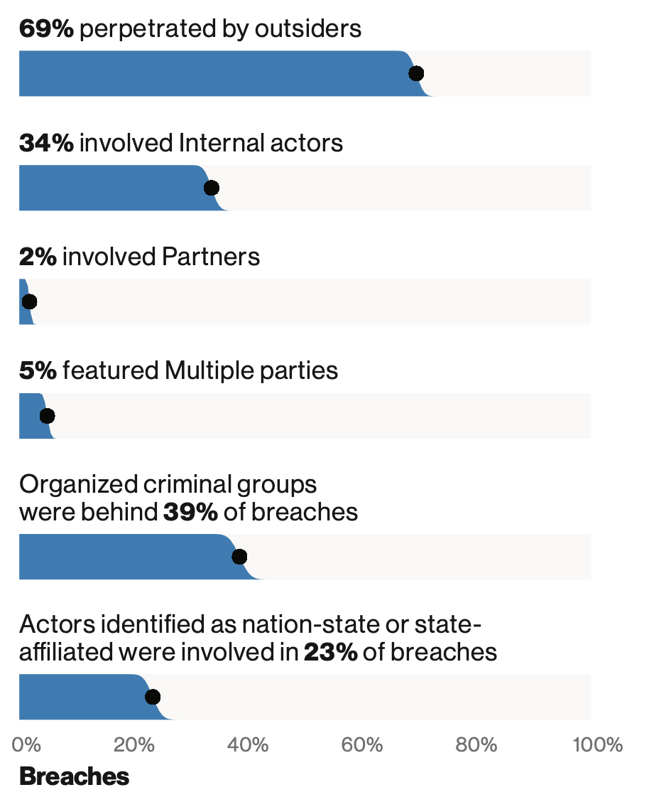
Human Threats
2018 breaches

Slide 9
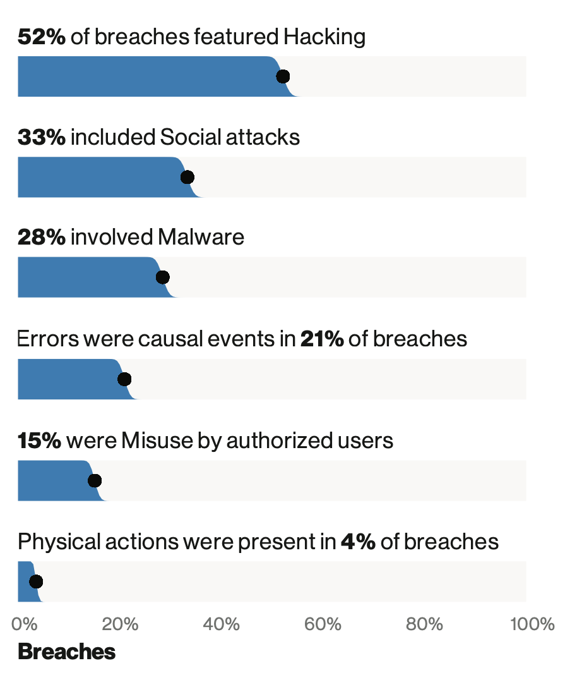
Human Exploits
2018 breaches

Slide 10
Attacks and Defences
Malware and attack technologies
Definitions and types (taxonomy) of malware
Analysis techniques
Defences
Adversarial Behaviours
Security operations and incident management
Forensics

Slide 11
System Security
Cryptography
History
Different forms of Cryptography
Keys, key strength
Contribution to Confidentiality and Integrity
Authentication, Authorisation and Accountability
Ensuring that specific known people and processes have access to data and functions to carry out specific tasks
Access Control (Role, Attribute and Code)

Slide 12
Software and Platform Secruity
Software security
Managing CIA in software
Software vulnerabilities
Detection
Remediation
Exploitation
Web and mobile security
Secure Software Lifecycle
Building, deploying and maintaining secure software
Microsoft Secure Development Lifecycle, SAFECode
Assessment

Slide 13
Infrastructure Security
Network security
Network Layers
Communication security
Network defence tools
Cyber-physical systems security
Internet of Things
Industrial Control Systems
Vulnerabilities and Defences

Slide 14
Learning Outcomes
To understand and be able to articulate
The language of Cybersecurity
The principles of preserving Confidentiality, Integrity and Availability
Principles of Risk Management
Cybersecurity in the domains of
* Human organisational and regulatory aspects, * Attacks and Defences, * System Security, * Software and Platform Security, * Infrastructure Security
Case studies will be used to illustrate and concretise language, terms and concepts throughout
Practical laboratory work will assist in practical aspects of Cybersecurity
An essay will allow for reflection on a topic in more depth

